Slide 1
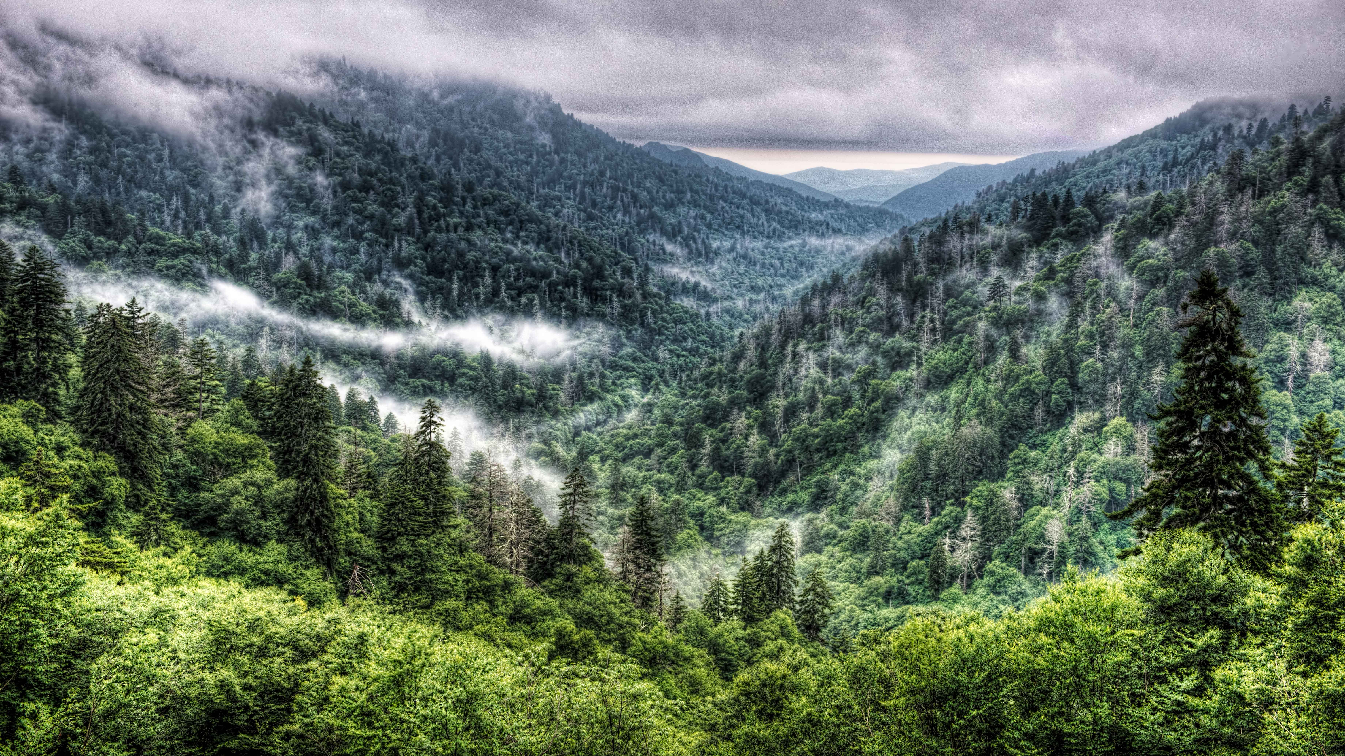
VISITED THE GREAT SMOKEY MOUNTAINS NATIONAL PARK?
Thank Edward John Meeman
Pugsley Recipient 1963

Slide 2
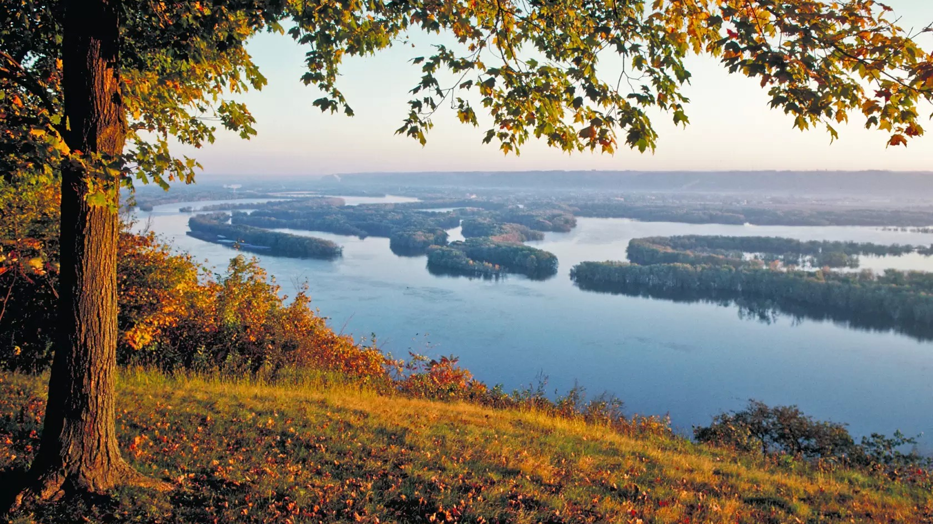
VISITED A STATE PARK IN IOWA?
Thank Margo K. Frankel
Pugsley Recipient 1932

Slide 3
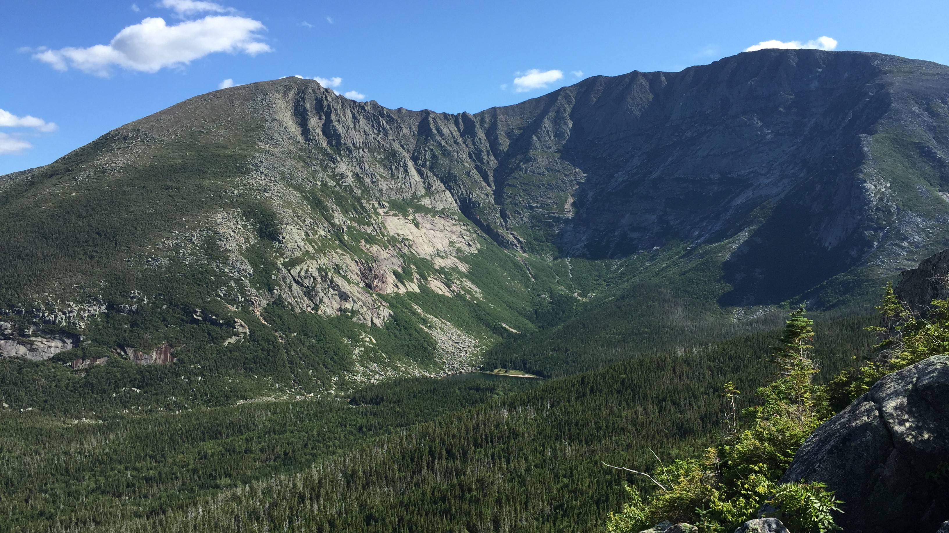
VISITED BAXTER STATE PARK IN MAINE?
Thank Percival Proctor Baxter
Pugsley Recipient 1932

Slide 4
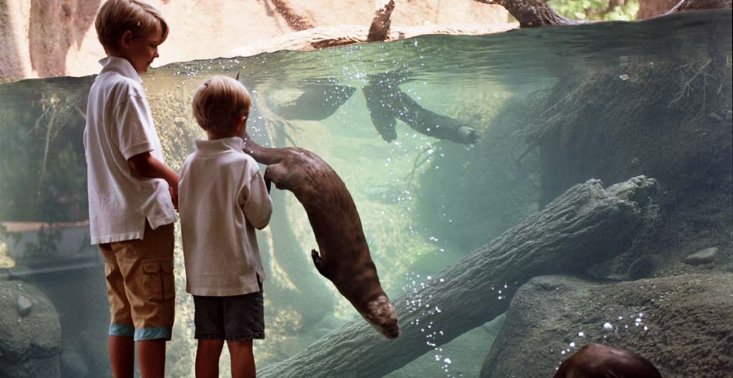
VISITED THE CHILDREN’S ZOO IN LINCOLN PARK?
Thank Daniel L. Flaherty
Pugsley Recipient 1964

Slide 5
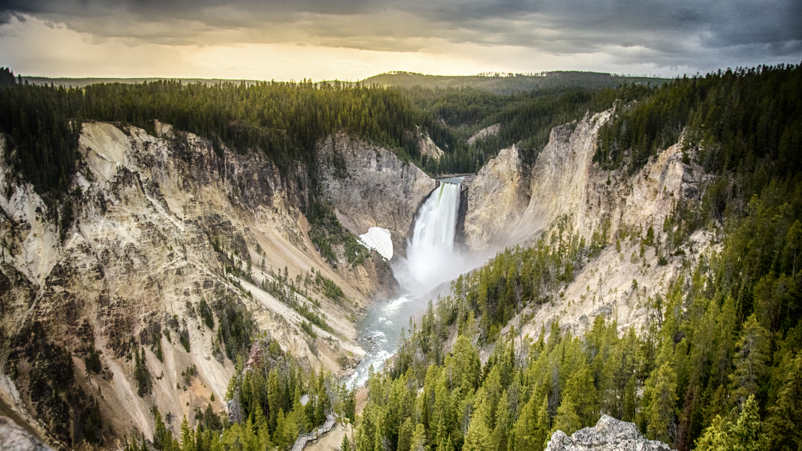
VISITED ONE OF OUR NATIONAL PARKS?
Thank Stephen T. Mather
Pugsley Recipient 1928

Slide 6
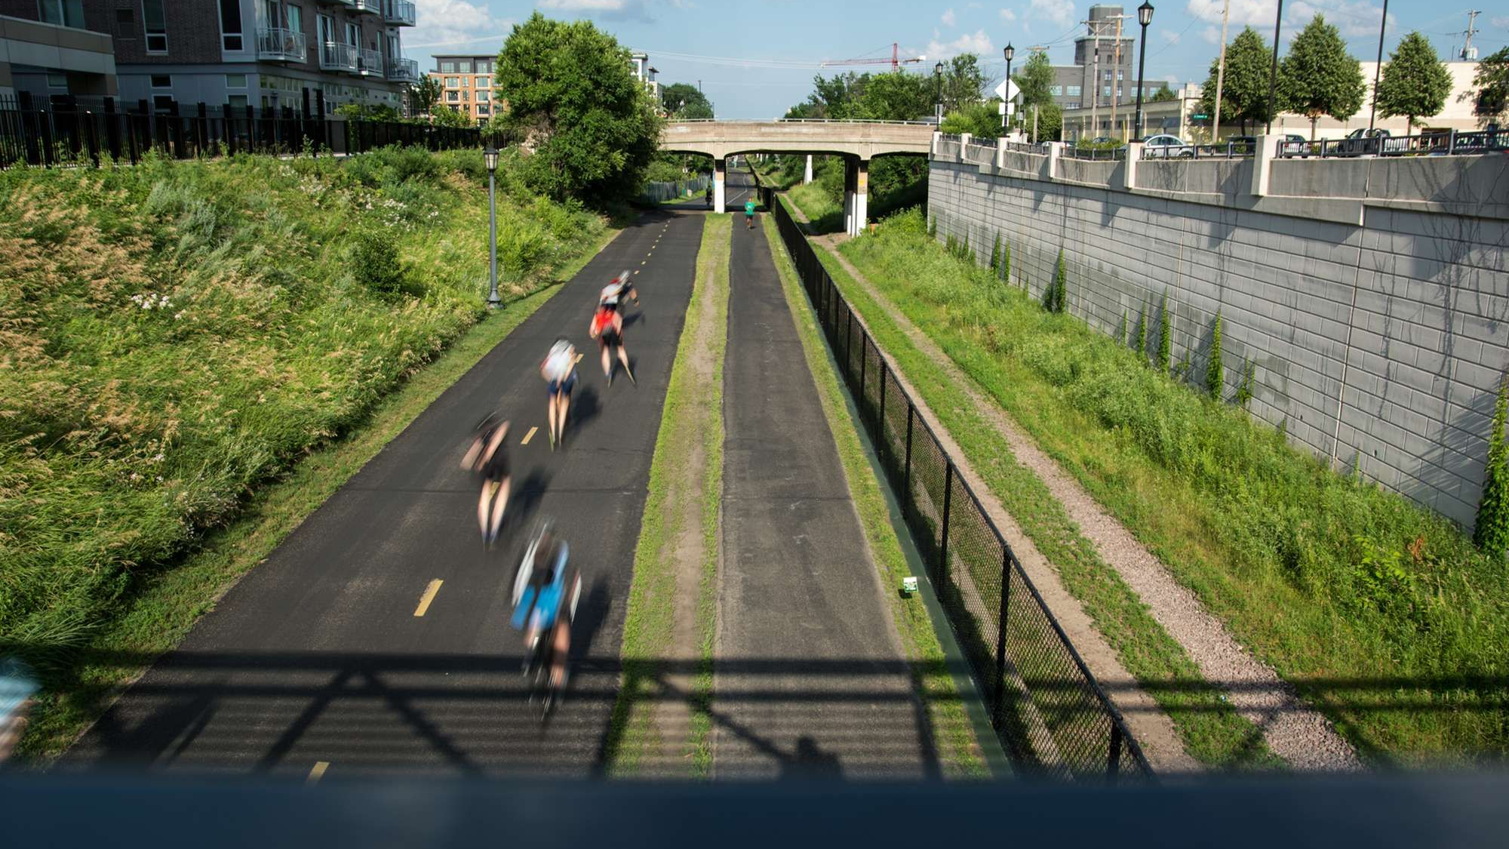
RIDDEN ON A BIKE TRAIL IN MINNEAPOLIS?
Thank Robert Ruhe
Pugsley Recipient 1970

Slide 7
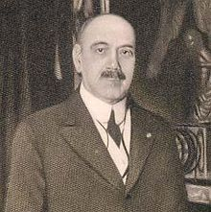
HISTORY Cornelius Amory Pugsley
In 1870, he started at Westchester County National Bank. Was the president for 46 years.
Cornelius’ son, Chester D. Pugsley, endowed a medals program to honor his father. The medal is to honor public park work in the United States.
The National Park Foundation accepted the administration of the medal program.
1850
1870
1901
1929
1953
1985
1996
Born in 1850 in Peekskill, Westchester County, New York.
Served a two-year term in the 57th Congress. He was very active in non-profit organizations. Became vice president of the Westchester County Park Commission.
In 1953 a new pattern emerged honoring individuals at the national, state/regional, and local levels.
The Foundation invited the American Academy for Park & Recreation Administration to make the final recipient selection.

Slide 8
HIGHLIGHTED RECIPIENTS 1928 – 1958
Robert Moses
Commissioner
City of New York
Roger W. Toll
First Superintendent Yellowstone National Park, Montana
Theodore Wirth
Minneapolis Park Board, Minnesota
Harlean James
American Planning and Civic Association
Gilbert Grosvenor
National Geographic Society, Washington D.C.
Percival Proctor Baxter
Governor, State of Maine
1928
1930
1932
1936
1940
1942
1947
1948
1955
1956
Stephen T. Mather Founding Director
National Park Service
Horace M. Albright
National Park Service
Beatrice Ward Nelson
National Conference on State Parks, Virginia
Peter Norbeck
United States Senator South Dakota
Margo K. Frankel
Citizen, Iowa Board of Conservation
William Albert Stinchcomb
Cleveland Park District, Ohio
Conrad Wirth
National Park Service
Ruth E. Peeler
Washington State Park Commission, Washington

Slide 9
HIGHLIGHTED RECIPIENTS 1959 – 1990
Russell B. Tobey
Division of Parks New Hampshire
Rhodell Owens
Peoria Park District Illinois
Frank Vaydik
City of Kansas City Missouri
Elo John Urbanovsky
Texas Tech University Texas
Robert W. Ruhe
Board of Park Commission Minneapolis, Minnesota
1960
1962
1964
1965
1969
1970
1972
1974
1979
1981
1988
Louis B. (“LB”) Houston
Dallas Park Board, Texas
Daniel L. Flaherty
Chicago Park District, Illinois
Ignatius “Nash” Castro
Palisades Interstate Park Commission, Washington, DC
William Penn Mott
California State Parks & National Park Service
Max D. Ramsey
Cultural Resources & Recreation, Tennessee Valley Authority, Tennessee
William R. Bird
Metropolitan Dade County Parks & Recreation, Florida

Slide 10
HIGHLIGHTED RECIPIENTS 1990 – 2002
Anne Springs Close
Citizen, Fort Mill, South Carolina
Joseph “Joe” J. Bannon
University of Illinois, Illinois
Ronald H. Dodd
Chicago Park District, Illinois
James A. Colley
City of Phoenix, Arizona
Ira J. Hutchison
National Park Service
Washington, D.C.
John L. Crompton
Texas A & M University, Texas
1990
1991
1992
1993
1995
1997
1998
1999
2000
2001
2002
Richard T. Trudeau
Director, East Bay Regional Park District California
Ralph S. Cryder
Los Angeles County Parks & Recreation California
Charles R. Jordan
City of Portland, Oregon
Fran P. Mainella
Florida State Parks; National Park Service
Carol M. Severin
East Bay Regional Park District, California
Bernadette Castro
State Park and Historic Preservation, State of New York

Slide 11
HIGHLIGHTED RECIPIENTS 2003 – 2016
John C. Potts
Champaign County Forest Preserve District, Illinois
M. Kathleen Perales
U.S. Army Corps of Engineers
Lamar Alexander
United States Senator
& Governor, Tennessee
Stuart Udall
United States Secretary of the Interior and United States Senator, Arizona
Beverly D. Chrisman
Irmo Chapin Recreation Commission, Irmo, South Carolina
Lady Bird Johnson
First Lady, Austin, Texas
2003
2005
2006
2007
2010
2013
2014
2015
2016
Robert G. Stanton
National Park Service
Washington, D.C.
Terese “Terry” Tarlton Hershey
Citizens Environmental Coalition, Texas
Tony A. Mobley
Indiana University, Bloomington, Indiana
Martin J. Rosen
Trust for Public Land, California
Charles H. Hartsoe
Virginia Commonwealth University, Richmond, Virginia
Katie L. Porter
National Recreation & Park Association, Ashburn, Virginia
Richard L. Ash
St. Charles, Missouri
John Sutter
East Bay Regional Park District, Oakland, California

Slide 12
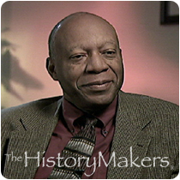
1995 CHARLES R. JORDAN Director, City of Portland, Oregon Considered the leading evangelist in parks and recreation, Charles started his career in Palm Springs, California. The majority of his career was spent in Portland, Oregon, where he was appointed the city’s first African American commissioner. There he served as the as Police, Parks and Fire Commissioners. He grew Portland’s system from 184 parks to 225 parks and natural areas. A powerful speaker, Charles staunchly promoted his parks & recreation “business” as “crime prevention.” He served on the President’s Commission on American Outdoors and as Chair of the Conservation Fund.
FEATURED AWARD RECIPIENTS
1997 IRA J. HUTCHISON Assistant Director, National Park Service, Washington, D.C. A pioneer in therapeutic recreation, Ira started at Topeka State Hospital, Kansas, serving as psychiatric aide, athletic instructor, recreation therapist, and the hospital’s recreation director. Moving to New York City, Ira worked with narcotic addicts. He then worked for the newly formed NRPA. The National Park Service appointed Ira as deputy director, making him the first African American deputy director. Upon retirement Ira formed Roundtable Associates, comprised of distinguished African Americans in parks, recreation, and conservation fields.
www.davey.com

Slide 13
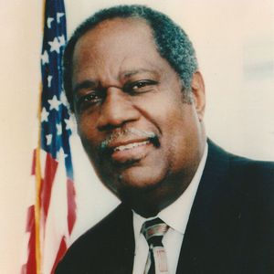
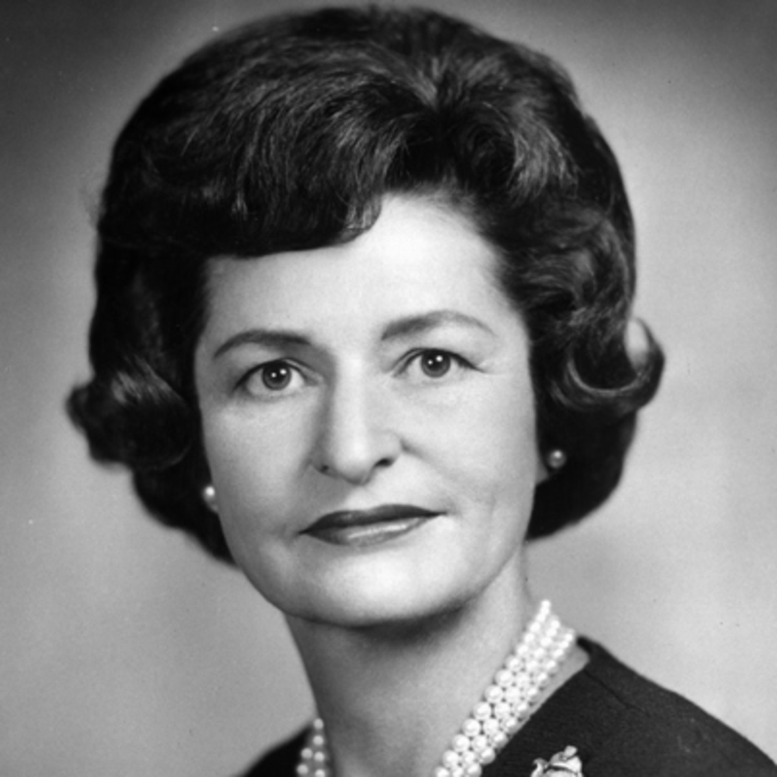
2003 ROBERT G. STANTON Director, National Park Service, 1997-2001, Washington, D.C. Appointed Director of the National Park Service in 1997. His first exposure to the NPS was at Grand Teton National Park as an intern. First NPS Director to be confirmed by the Senate. It was said "through his 34-year career with NPS he distinguished himself with leadership, commitment, and dedication."
FEATURED AWARD RECIPIENTS
2005 LADY BIRD JOHNSON First Lady, Austin, Texas Through her personal leadership in development of park systems in Washington, D.C., and Austin, Texas, she became an advocate for communities across the nation bringing beautification and conservation to the national agenda. She sought passage of the Highway Beautification Act of 1965. Turned the National Wildflower Research Center to a membership organization of 25,000 with visitations exceeding 100,000 per year.
www.davey.com

Slide 14
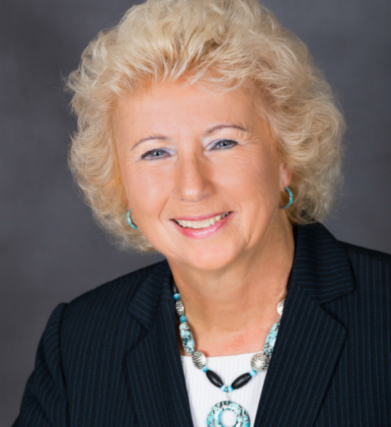
1998 & 2007 FRAN P. MAINELLA Director, Florida State Parks; Director, National Park Service A two-time recipient, Fran received her first Pugsley for her work while Florida’s State Park Director. During her tenure, Florida State Parks became a model for its volunteer & partnership programs. She was appointed the 16th and first female National Park Service Director in 2001. Partnerships continued to be her emphasis, mandating civic engagement and public involvement in director’s order 75A. She created a multi-state national park; Great Sand Dunes National Park; the Lewis & Clark National Historic Park; the memorial for United Flight 93; and the preservation of 9,000 Texas acres of long-leaf pine forests.
FEATURED AWARD RECIPIENTS
2016 RICHARD L. ASH Director, St. Charles, Missouri Using his core values as his base, Richard worked nearly 40 years improving communities and the state of Missouri. During his 26-year tenure in St. Charles the operating and capital budget grew as did its acreage with a corresponding increase in staff and parks. A strong fiscal conservative, he often spoke on fiscal management. Richard was a key player in the development of the Great Rivers Greenway District, a bi-state, five-county, special district. His love of the outdoors led him to the Conservation Federation of Missouri where he served as its President.
www.davey.com

Slide 15
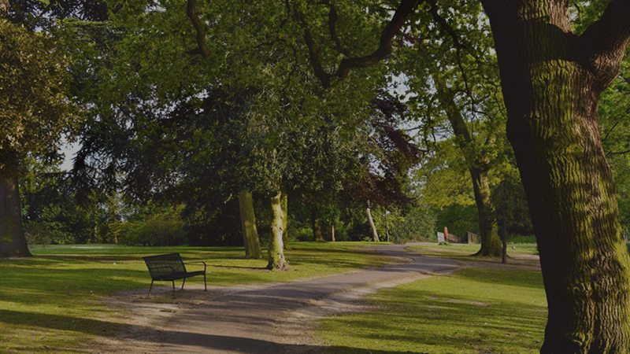
THANKS TO OUR SPONSORS
The Davey Tree Expert Company Davey’s approximately 9,000 employees provide diversified tree services, grounds maintenance and environmental services throughout the U.S. and Canada. Davey has provided Proven Solutions for a Growing World since 1880 and has been employee-owned for 38 years.
National Park Foundation A Congressionally chartered partner of America’s National Parks, the foundation works to protect our national parks, monuments, beaches, rivers, mountains, and historic sites. It works to connect Americans with these places and inspire our next generation of national park stewards.
AAPRA AAPRA is comprised of high-level experienced professionals dedicated to the advancement of public parks & recreation. The Academy mentors professionals, acknowledges high performing park & recreation agencies, and furthers scholarly research to advance the profession.

Slide 16
There are now
226 RECIPIENTS
of the Honorable
Cornelius Amory Pugsley Awards
Davey Tree salutes these heroes and others who work diligently to provide, protect, and enhance our nation’s greatest treasures: its natural resources.
To learn more about the recipients of the distinguished Pugsley Award visit http://www.aapra.org/pugsley-award
VISITED THE GREAT SMOKEY MOUNTAINS NATIONAL PARK?
Thank Edward John Meeman
Pugsley Recipient 1963

